Slide 1

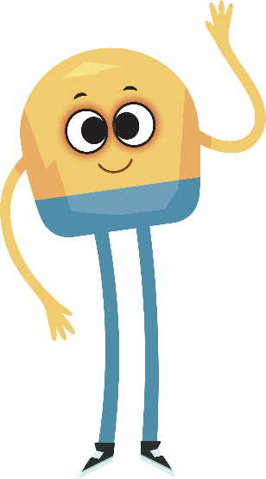

Unit 5: Week 4
Grade K

Slide 2
Copyright © Savvas Learning Company LLC. All Rights Reserved.
This publication is protected by copyright, and permission should be obtained from the publisher prior to any prohibited reproduction, storage in a retrieval system, or transmission in any form or by any means, electronic, mechanical, photocopying, recording, or otherwise. For information regarding permissions, request forms, and the appropriate contacts within the Savvas Learning Company Rights Management group, please send your query to:
Savvas Learning Company LLC, 15 East Midland Avenue, Paramus, NJ 07652
or
k12learningpermissions@savvas.com
myView Literacy® is an exclusive trademark of Savvas Learning Company LLC in the U.S. and/or other countries.

Slide 3

Lesson 1

Slide 4
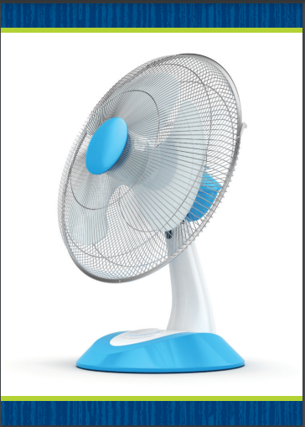

Page 124
Phonological Awareness
Notes:
Hold up the fan Picture Card. Listen to this word: /f/ /a/ /n/, fan. What are the sounds you hear in fan? Students should say /f/ /a/ /n/. Let’s change the sound /f/ in fan to make a new word. We will change the /f/ to /b/. Listen: /b/ -an. The new word is ban. Continue substituting beginning, middle, and ending phonemes to make these words: bat, bet, met, mat, map. Click path -> Table of Contents -> Unit 5 Week 4 Informational Text -> Lesson 1
Display the kite Picture Card. Guide students as they look at the picture and say the word. Have them slowly segment the phonemes. Then have them substitute the beginning, middle, and ending phonemes to make new words, such as Kate/late, late/lace, lace/lice, lice/mice. Have students name the word that explains the second picture on Student Interactive p. 124. (sit) Then have them substitute beginning, middle, and ending phonemes to make new words, such as fit/fill, fill/fall, fall/mall.

Slide 5
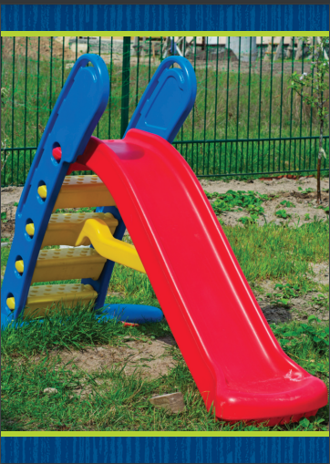
Page 124
Phonics
Kate
Kim
kid
sat
set
Sam
Notes:
Hold up the kite Picture Card. What sound do you hear at the beginning of kite? Have students identify /k/. The letter k spells the sound /k/ in kite. Turn the card over and read the word kite with students. Have students tell you the letters that are in the word kite. Click path -> Table of Contents -> Unit 5 Week 4 Informational Text -> Lesson 1
Now let’s practice reading more words with the sound /k/. Write the words Kate, Kim, and kid on the board. The first letter in each of these words, k, spells the sound /k/. Circle the k in each word. Read the list with students. Repeat the activity for the letter Ss using the slide Picture Card and these words: sat, set, self, Sam.
Write these words on the board: Kip, sand, sip, kit. Have students read the words together.

Slide 6
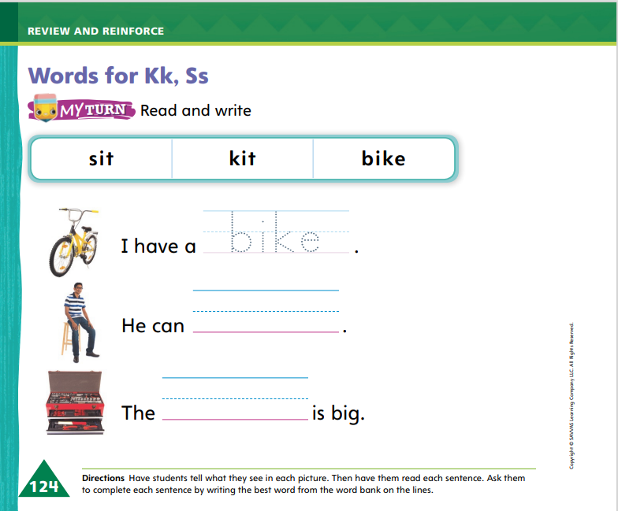
Page 124
Phonics
Turn to page 124 in your Student Interactive and complete the activity.
Notes:
Have students look at p. 124 in the Student Interactive. Read the words with students. Now we will use these words to complete the sentences. What does the first picture show? Students should say a bike. What word finishes the sentence I have a ___ and tells about the first picture? Students should say bike.
Have students write the word bike on the line. Then have them complete the activity.

Slide 7
High-Frequency Words
out
so
then
Notes:
Display the high-frequency words out, so, and then, and read them aloud.
Have students point to the word out and read it.
Repeat for so and then.

Slide 8
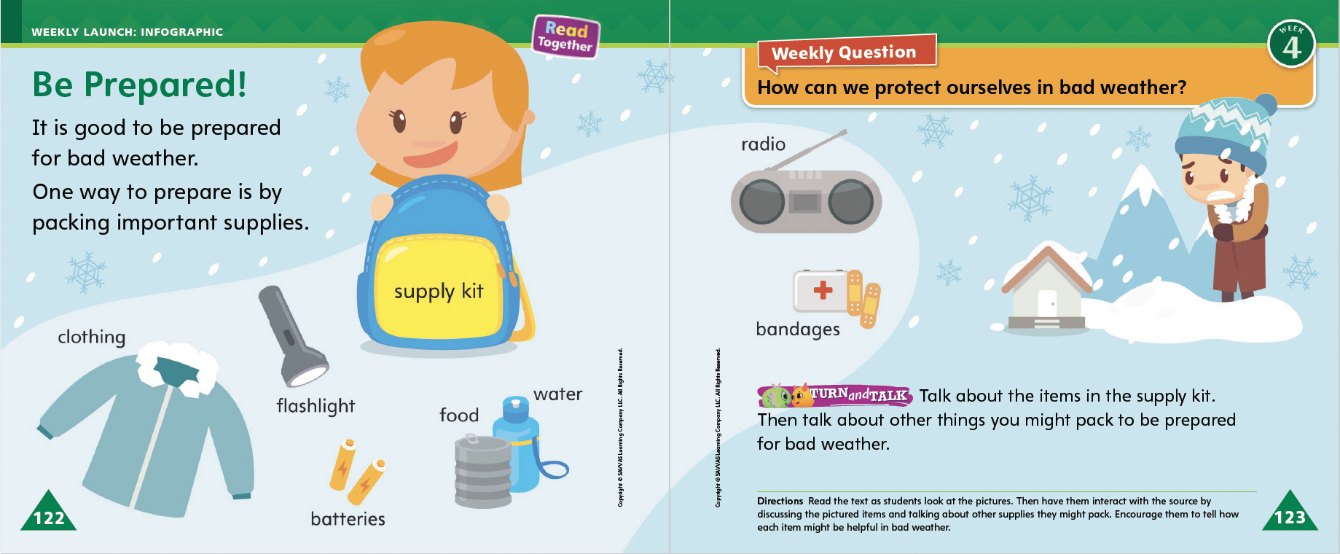
Page 122, 123
Interact with Sources
Talk about the items in the supply kit.
What else might you pack?
Notes:
Have students recall the Unit 5 Essential Question: What can we learn from the weather? Then introduce them to the Weekly Question: How can we protect ourselves in bad weather? Tell students that they should stay indoors during bad weather. Explain that bad weather might be rain, snow, or storms. Tell students we can learn a lot about how to protect ourselves and stay safe in bad weather.
Have students follow along as you turn to p. 122 of the Student Interactive and point to the pictures of the supplies people gather to get ready for bad weather. Then read the infographic to students and use the points below to help them follow along.
Ask students to talk about how the boy in the picture on p. 123 of the Student Interactive feels during the snowstorm.
Ask students to point to and name each of the items in the supply kit on pp. 122–123. Help them read labels and identify objects as needed.
Ask students to think about how each item in the kit can help people stay safe in bad weather.
Have students summarize what they can do to get ready for a storm or other types of bad weather.
Have students interact with sources by using the pictures and text on pp. 122–123 to talk about the kind of supplies they would pack to get ready for bad weather.
Return to the Week 4 Question: How can we protect ourselves in bad weather? Invite students to share their ideas. Help them identify questions they may have about the infographic.

Slide 9
Listening Comprehension
Saving Water
1. Drought
2.
3.
4.
Notes:
Tell students that you are going to read aloud an informational text. Remind them that informational texts give facts and details about real topics. This informational text is about droughts and why and how people save water. Ask students to actively listen to the text you will read aloud.
Have students listen actively to determine the purpose for the text.
Read the entire text aloud without stopping for the Think Aloud callouts.
Reread the text aloud, pausing to model Think Aloud strategies related to the genre.
Use the chart to help students identify facts and details about saving water.

Slide 10
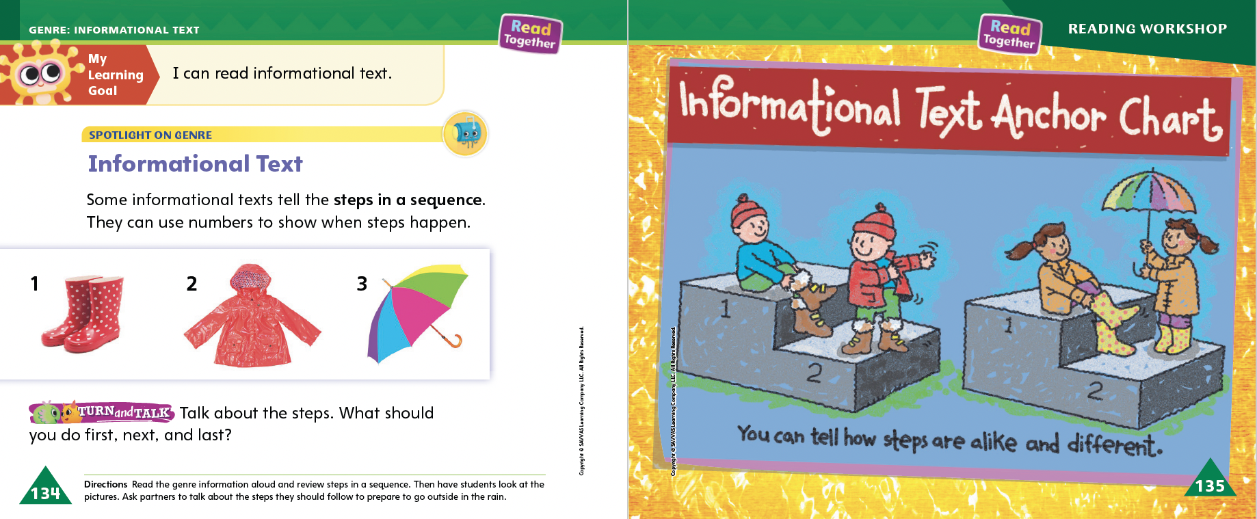
Page 134, 135
Informational Text Qualities
Turn to page
134 in your Student Interactive.
Notes:
Tell students that today they will learn about informational texts. Informational texts tell about real things or events. Informational texts give facts and do not tell a story.
Informational texts can tell the steps of a sequence.
Some informational texts tell the reader how to do something.
Steps in a process may be numbered like a list.
Restating the steps in a sequence aloud can help readers understand an informational text.
Remind students that steps in a sequence can be identified by looking for numbered lists or cue words such as first, next, and last. Model looking for steps using the Read Aloud text. Say: I see a numbered list in this informational text, so I think it is telling me the steps in a process. These steps tell how to save water during a drought. I can retell the steps in order and follow or act out the steps I say to help me remember what to do. Read the steps aloud to students and have them orally restate the steps in order.
Read the text and review the Anchor Chart on pp. 134-135 of the Student Interactive. Editable Anchor Chart Click Path: Table of Contents -> Reading Anchor Charts -> Unit 5 Week 4: Informational Text Editable Reading Anchor Chart

Slide 11
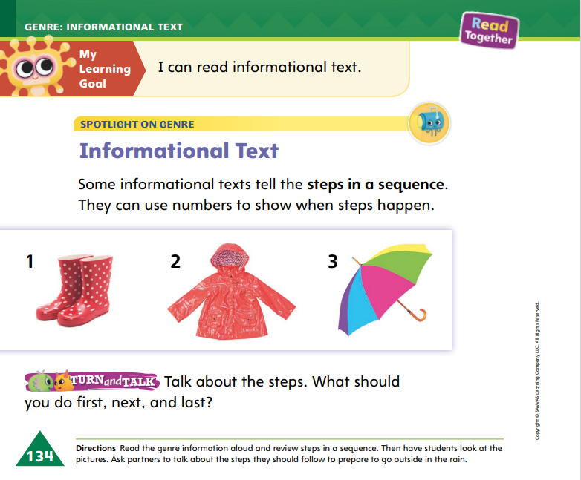

Page 134
Apply
Talk about the steps.
What should you do first, next, and last?
Notes:
Have students use strategies for identifying sequences in informational text.
Have students turn and talk with a partner about the steps shown on p. 134. They should take turns restating what to do first, next, and last. Have students follow the directions by acting out the steps as their partner restates them.

Slide 12
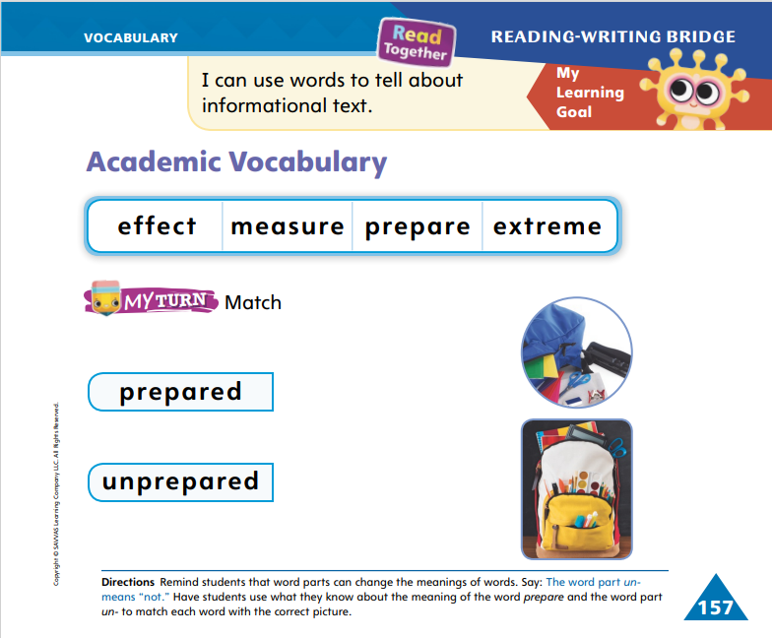
Page 157
Academic Vocabulary
work
Turn to page 157 in your Student Interactive and complete the activity.
kind
jump
ask
Notes:
Explain to students that word parts are small parts of words that are added to a word to make a new word. Word parts can change the meaning of a word.
Explain that we add -ed to some words to show that an action happened in the past.
We can add un- to the beginning of a word to make a word with an opposite meaning.
Write the words work and kind. Model how word parts change the meaning of words. I can add -ed to the word work to tell what I did yesterday: I worked hard yesterday. I can describe someone who is not kind by adding un-: She is very unkind.
Write the words jump and ask. Have students add -ed to the end of each word and tell what the new words are. Write open and even. Have students add un- to the beginning of each word and tell what the new words are.
Have students match the vocabulary words with the proper picture to complete p. 157 in the Student Interactive.

Slide 13

Handwriting
He can hop.
Notes:
Explain to students that a sentence starts with a capital letter at the beginning of the first word and ends with a punctuation mark, such as a period.
Demonstrate for students how to write a simple, complete sentence. I want to write this sentence: He can hop. I need to start the first word with a capital H. I make sure I form the letters correctly. Write the word He. Now I need to make sure to leave a space before the next word, can. Write can, leaving a space after He. Now I write the last word, hop. I leave a space and make sure I form the letters correctly. I finish the sentence with a period. Finish writing the sentence, and add a period. Demonstrate additional simple sentences as needed.
Have students use Handwriting p. 274 from the Resource Download Center to practice writing simple sentences. Tell students to include spaces between words and to form letters accurately using appropriate directionality. Click path: Realize -> Table of Contents -> Resource Download Center -> Handwriting Practice -> U5W4L1 Handwriting Practice

Slide 14
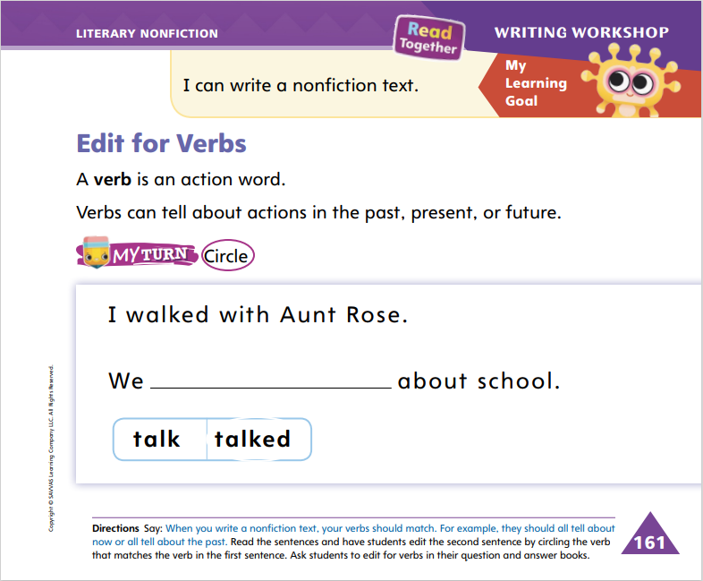
Page 161
Writing – Literary Nonfiction
Turn to page 161 in your Student Interactive.
Notes:
Verbs are action words. They can tell about actions that are happening now, happened in the past, or will happen in the future.
Use stack texts to point out past, present, and future tense verbs. Explain that if a text is written in the present tense, the verbs usually stay in present tense. Use examples from a stack text to demonstrate. On the board, make a three-column chart with the headings past, present, and future. Tell students that verbs in the past usually end with -ed. Verbs in the present usually end with -s or -ing, and verbs in the future begin with will. Read a stack text together and point out the verbs. Write all three tenses of the verb in the chart. Have students help you.
Choose a present-tense sentence from a stack text, and write it on the board. Be sure the verb in the sentence is a regular verb. Say: Today I will show you how to edit your drafts for the correct use of verbs. Let’s read this sentence together. Read the sentence aloud to students. This sentence is written in the present tense. The action is happening now. I know this because the verb is in the present tense. Underline the verb in the sentence. Now I want to edit this sentence so it happens in the past. How should we edit this verb so that it is a past-tense verb? Guide students to add an -ed. Now let’s reread the sentence. By adding an -ed to the verb, we made the action happen in the past. Read the sentence aloud. Repeat the activity, asking students to help you change the sentence to future tense.
Direct students to complete the activity on p. 161 in the Student Interactive. Provide assistance as needed.

Slide 15

Independent Writing
Let’s review your books to make sure each verb is in the correct tense.
Share one of your sentences with the class. Identify if the verb is past, present, or future tense.
Notes:
Students should transition to reviewing their books to make sure each verb is in the correct tense.
Writing Support
Modeled - As you model writing, emphasize usage of verbs to tell the action in a book.
Shared - Use stack texts to point out verb tenses and usage.
Guided - Prompt students to think about what verb tense to use in their writing.
When students finish editing for verbs, they can continue writing or editing their books.
Call on a few students to read their sentences aloud to the class. Have students identify whether the verb is in the past, present, or future tense, and engage students in a discussion about why they used this tense.

Slide 16
Spelling
We swim in the pool.
Mat can skip and jump.
Do not step in the puddle!
The dog has a white spot on its face.
Can I go out to play?
I am tired, so I will take a nap.
Notes:
(Note: Move the orange boxes to cover each bold spelling word before you read aloud the words and sentences.)
Read aloud the words and sentences. Have students spell each word with initial consonant blends and the two high-frequency words.
We swim in the pool.
Mat can skip and jump.
Do not step in the puddle!
The dog has a white spot on its face.
Can I go out to play?
I am tired, so I will take a nap.
Reveal the spelling word and have students check their work.

Slide 17
Language and Conventions
I have a beautiful dog.
Identify the adjective in the sentences and the word it describes.
Notes:
Remind students that an adjective is a word that describes a person, place, thing, or an idea. Tell students that adjectives help give more detail about a subject.
Give an example of a sentence with an adjective, and help students identify the adjective. Say: In the sentence, I have a beautiful dog, there is an adjective. It’s a word that describes the dog. The dog is described as beautiful. So beautiful is the adjective in this sentence.
Find sample sentences in the classroom library or in the Student Interactive, and challenge students to locate an adjective and tell which word it describes.

Slide 18
Lesson 2

Slide 19
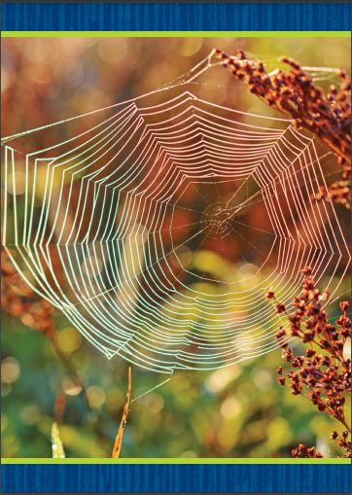
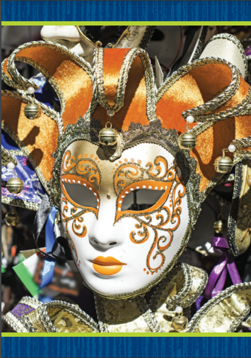
Phonics
web
mask
Notes:
Hold up the web Picture Card. This is a picture of a web. Listen to the sounds in the word: /w/ /e/ /b/. I hear the sound /w/ at the beginning of web. Say the sound /w/ with me. Turn the card over so students can see the spelling. What letter spells the sound /w/ in web? Students should say w.
Hold up the mask Picture Card. This is a picture of a mask. Listen to the sounds in the word: /m/ /a/ /s/ /k/. I hear the sound /m/ at the beginning of mask. Say the sound /m/ with me. Turn the card over so students can see the spelling. What letter spells the sound /m/? Students should say m. Click path -> Table of Contents -> Unit 5 Week 4 Informational Text -> Lesson 2
Listen carefully to the following words: win, wide, make, mom. What sound do you hear at the beginning of each word? Say the words one at a time, and have students identify the beginning sound in each word.

Slide 20
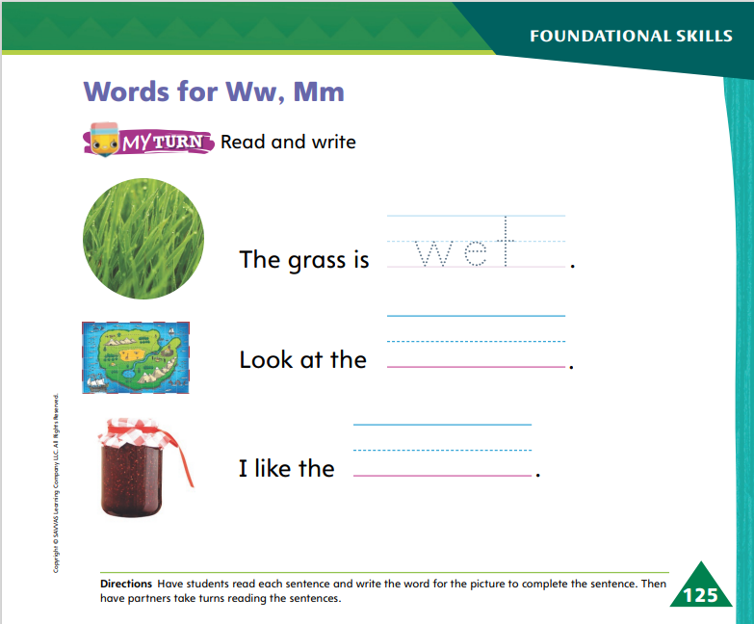
Page 125
Apply
Turn to page 125 in your Student Interactive and complete the activity.
Notes:
Have students complete p. 125 in the Student Interactive.

Slide 21
High-Frequency Words
out
so
then
Notes:
Tell students that high frequency words are words that they will hear and see over and over in texts.
Write and read the words out, so, and then.
Have students repeat the words after you.
Have students spell each word, clapping as they say each letter.

Slide 22
Page 136
Preview Vocabulary
tornado
powerful
Notes:
Introduce the vocabulary words on p. 136 in the Student Interactive and have students raise a hand if they know the word.
Have students share what they already know about the words. Provide prompts: What happens in a tornado? Can you think of someone or something powerful?
These words are used in the selection Tornado Action Plan. Let’s see if we can find them together as we read.

Slide 23
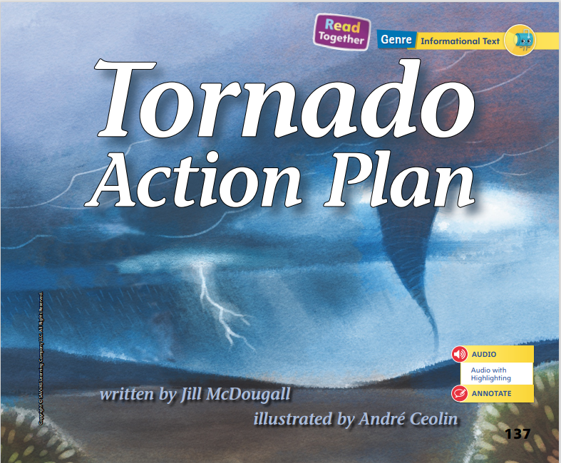
Page 137
First Read Strategies
Notes:
Discuss the First Read Strategies with students. In this first read, encourage students to read for understanding and enjoyment. After students complete the First Read, ask: What is the text about? What did you like best? What did you learn?
First Read Strategies
READ Read or listen to the text. During the first reading, think about the main topic and the most important details.
LOOK Look at the pictures to understand more about what to do before and during a tornado.
ASK Generate, or ask, questions about the text to deepen understanding.
TALK Talk to a partner about the steps to follow if a tornado comes.
Students may read independently, in pairs, or as a class. Use the First Read notes to help them connect with the texts and to monitor comprehension.

Slide 24
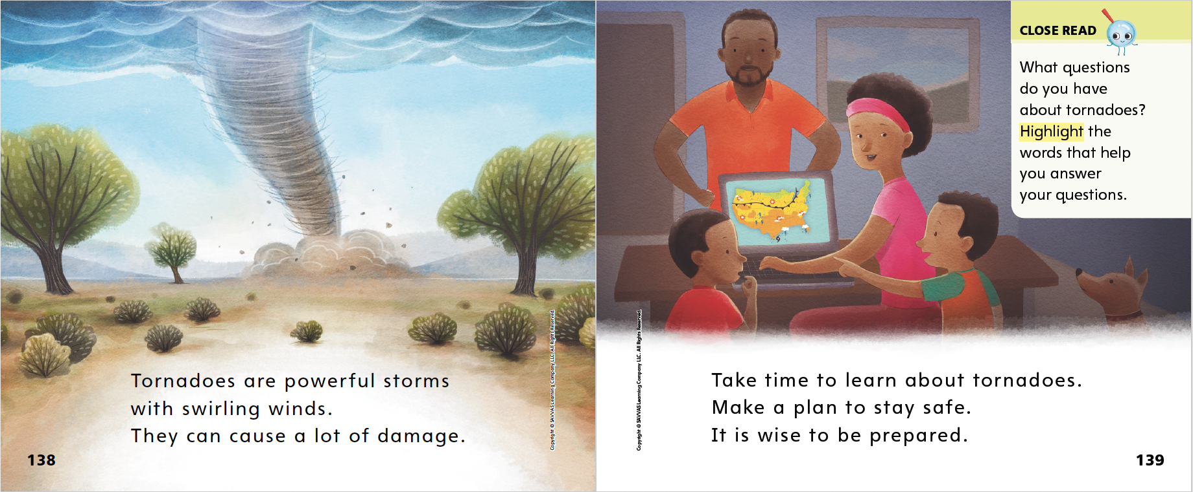

Page 138, 139
First Read – Tornado Action Plan
Notes:
Read Together.
THINK ALOUD I see the word swirling on p. 138. If I don't know what this word means, I can look at the pictures for clues. The picture helps me see that swirling means spinning around and around, like the winds that reach from the clouds to the ground.

Slide 25
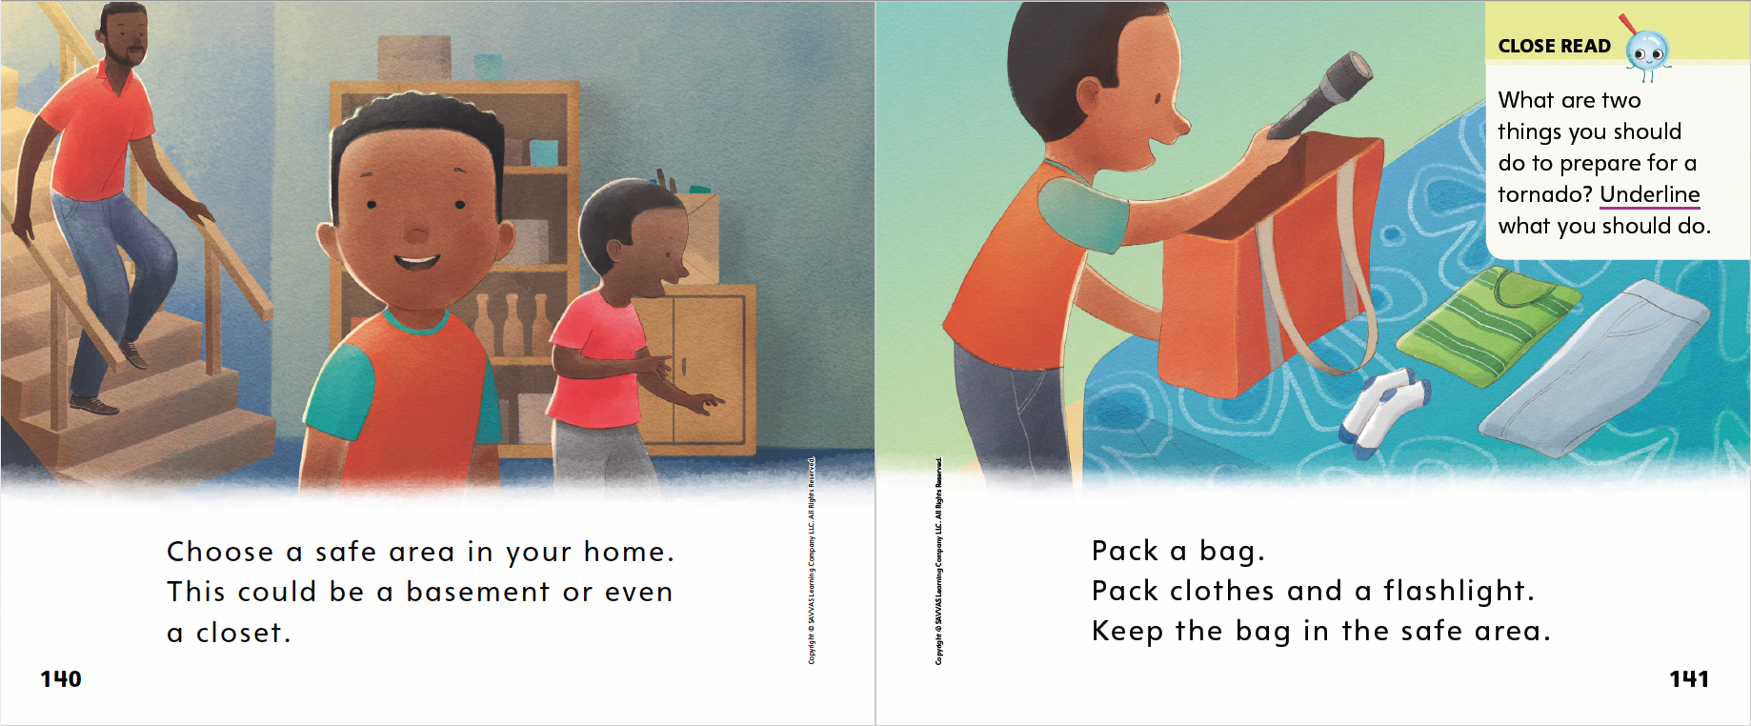
Page 140, 141
First Read – Tornado Action Plan
Notes:
Read Together.

Slide 26
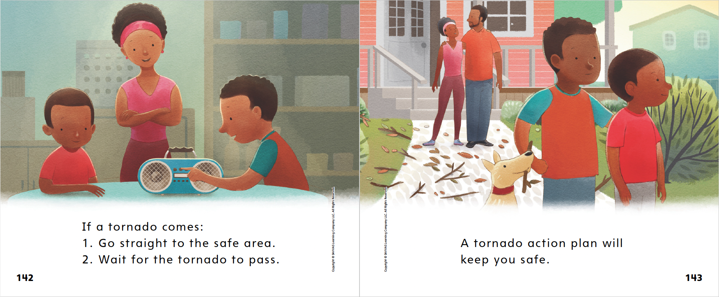
Page 142, 143
First Read – Tornado Action Plan
Notes:
Read Together.
THINK ALOUD There is a numbered list on page 142. It tells what to do when a tornado comes. This list makes me think of the features of an informational text. The list shows the steps of a sequence. I know that these steps should be done in order.

Slide 27
Page 144
Preview Vocabulary
strong
blizzard
Notes:
Introduce the vocabulary words on p. 144 in the Student Interactive.
Ask students to share what they already know about these words. Prompt with questions: Can you think of someone who is strong? What time of year might you see a blizzard?
Ask students to look and listen for these words as you read Blizzard Action Plan.

Slide 28
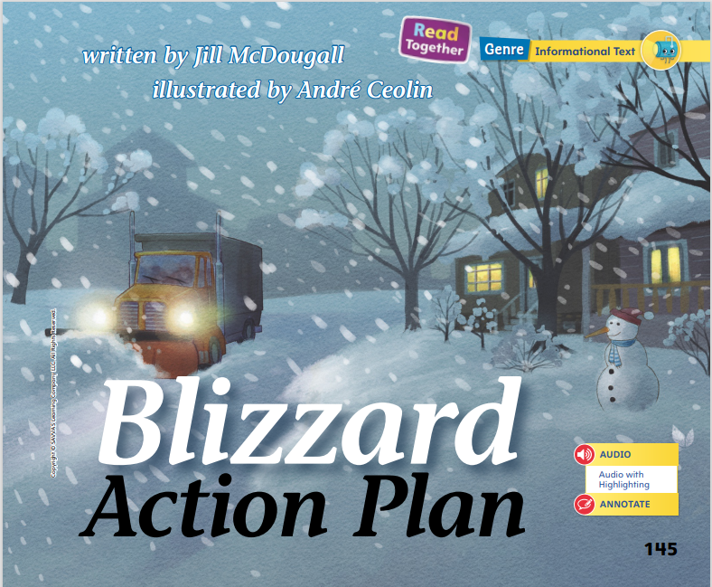
Page 145
First Read Strategies
Notes:
Prepare students to compare and contrast ideas across texts. We just finished reading Tornado Action Plan. As we read Blizzard Action Plan, think about how the steps for a tornado action plan and a blizzard action plan are alike and different. Discuss the First Read Strategies with students.
First Read Strategies
READ Read or listen to the text. During the first reading, work to understand what the text is about.
LOOK Look at the pictures to help you understand more about what a blizzard looks like and what you can do to stay safe.
ASK Generate, or ask, questions about the text to deepen understanding.
TALK Talk to a partner about the texts and the steps for staying safe during a blizzard and a tornado.
Help students read independently, in pairs, or as a class. Use the First Read notes to help students connect with the texts and monitor comprehension.

Slide 29
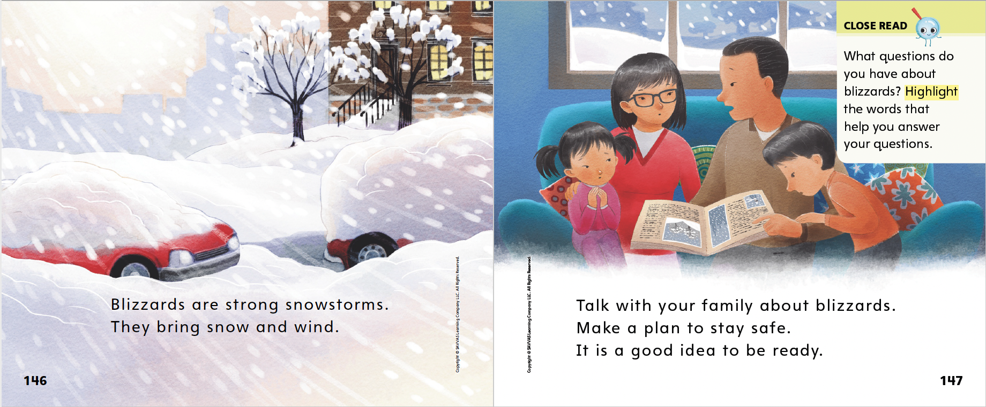
Page 146, 147
First Read – Blizzard Action Plan
Notes:
Read Together.
THINK ALOUD I see that the text on page 146 tells me what a blizzard is. It says here that it is a strong snowstorm. I can tell from the picture that blizzards are very windy, too. The text also says that blizzards bring wind.

Slide 30
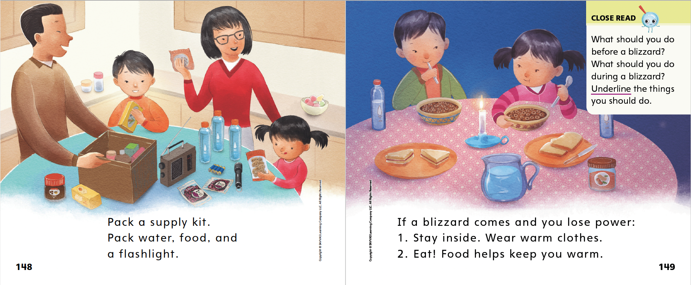
Page 148, 149
First Read – Blizzard Action Plan
Notes:
Read Together.

Slide 31
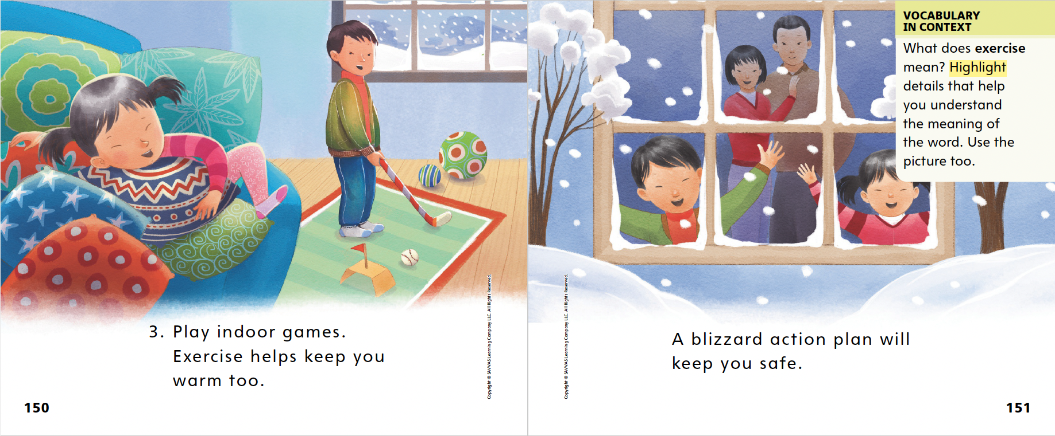
Page 150, 151
First Read – Blizzard Action Plan
Notes:
Read Together.
THINK ALOUD The text says that exercise keeps us warm. I wonder what kinds of things I can do for exercise indoors. I guess playing on the pillows like the girl in the pictures on page 150 is a kind of exercise. So is playing indoor golf. These things can keep me warm if I am cold, and they are fun too.

Slide 32
Respond and Analyze
Talk: Restate the directions for tornado and blizzard action plans. Act out the steps.
Retell: Summarize what each text was about.
Notes:
Model following and restating oral directions using the act of brushing your teeth. Say the steps before and after each gesture. Next, direct the steps toward students, having them follow oral directions by mimicking the actions, and then ask them to restate the step afterward. Then summarize the informational texts Tornado Action Plan and Blizzard Action Plan one at a time for students. Explain that telling steps you have read about in order and following or acting out the steps you say can help you remember what to do. Orally retell the steps for each action plan as you act out the steps.
Talk Ask students to find a page or picture that they thought was interesting or a fact about tornadoes or blizzards that they did not know before. Invite them to restate the directions for tornado and blizzard action plans and follow the directions by acting out the steps.
Retell Ask students to summarize what each text was mostly about.

Slide 33
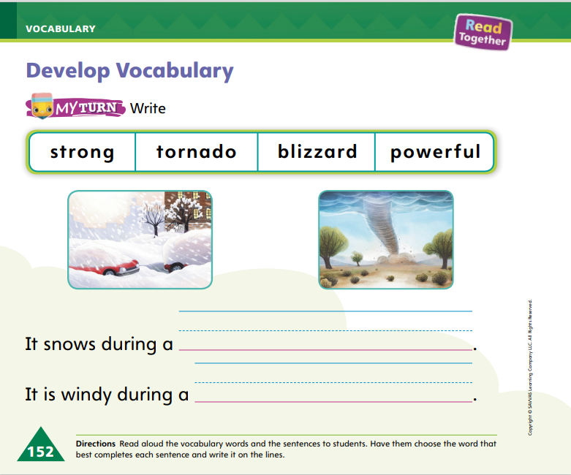
Page 152
Develop Vocabulary
Turn to page 152 in your Student Interactive and complete the activity.
Notes:
Explain to students that readers can use nearby words and pictures to figure out the meaning of an unknown word in a text.
READ Read the word.
THINK Think about the meaning of the word. Use nearby pictures and text to help you understand the word’s meaning.
ASK Ask yourself questions, such as How do the pictures help me understand the meaning of the word?
Think aloud about how to complete the activity on p. 152 of the Student Interactive. The words snows and windy can help me know whether to use the word blizzard or tornado. I know that a blizzard is both a snowy and windy weather event. A tornado is just a windy weather event. Provide additional support to students as needed.
Have students look at the word powerful on p. 138 and the word strong on p. 146. Invite partners to talk about how the words are similar and how they are both used to describe bad storms. Then have them complete the activity on p. 152 in the Student Interactive.

Slide 34
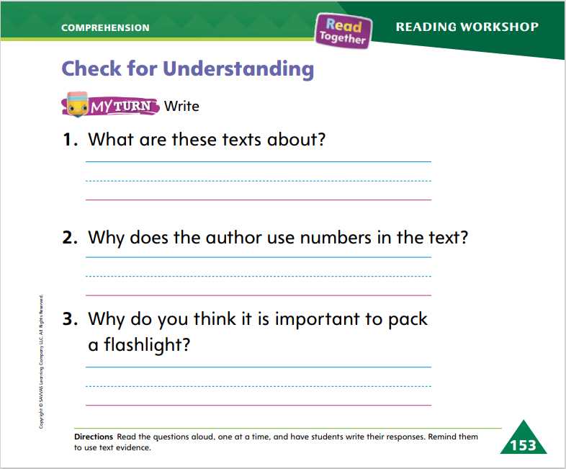
Page 153
Check for Understanding
Turn to page 153 in your Student Interactive and complete the activity.
Notes:
Have students complete the Check for Understanding on p. 153 of the Student Interactive.

Slide 35
Writing – Literary Nonfiction
Today we are going to talk about typing our book on a computer.
What do each of the following keys do?
Delete
Space
Backspace
Return
Notes:
Many authors write their books on laptops, tablets, or other digital tools. Some authors may hand-write their notes or drafts in a notebook and then transfer them to digital tools. Authors type their books on computers or tablets so they can then be printed or published.
Show a laptop or tablet and explain to students that people first learn to write using paper and pencil. But for most authors, using digital tools, such as computers, makes it easier to compose a book. Model writing a sentence from a stack text on paper and then typing the sentence onto a computer. Think aloud as you show how you can easily revise work done on a computer. Say: When I write by hand, I have to go back and erase my writing if I want to make changes. Sometimes, there’s not enough space to add in the text I want, so it looks messy. When I write on a computer, the text changes as I edit. It’s very easy to make changes on the computer.
Point out the “delete,” “space,” “backspace,” and “return” keys on a keyboard or tablet, showing students what each key does and how it can help them write and edit.

Slide 36
Independent Writing
Type your draft using the computer.
Explain the difference between writing by hand and writing using digital tools.
Notes:
After this lesson, students should continue writing and editing their drafts and then transition to using digital tools. If possible, have computers available for students to use to produce their writing.
Writing Support
Modeled - Draft a sentence on paper and then type it on a laptop. Make an error and use the backspace or delete key to correct it so students understand how those keys work.
Shared - Have students write their sentence and then type it. Help them make any corrections or changes.
Guided - Guide students in using digital tools to transcribe their writing.
Call on several students to explain the difference between writing by hand and writing using digital tools. Engage students in a discussion about using digital tools to write.

Slide 37
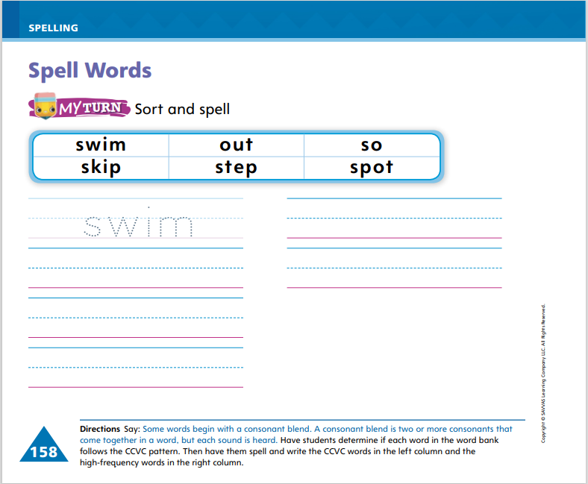
Page 158
Spelling
Turn to page 158 in your Student Interactive and complete the activity.
swim
Notes:
Explain that in words with initial consonant blends, both letters are heard and spelled.
Write or display the following CCVC word: swim. Say the word aloud and point out that the letters s and w are both spelled and heard at the beginning of the word.
Have students complete the activities on p. 158 in the Student Interactive.

Slide 38
Language and Conventions
I have a brother.
I have a funny brother.
Brainstorm adjectives to expand sentences.
Notes:
Explain to students that they can become better writers by adding words to their sentences to give more details. Remind them that adjectives are words that describe people, places, things, or ideas. Explain that when we add adjectives, we make the sentence longer. We also add more information and make the sentence more detailed.
Give an example of how to expand a sentence by adding an adjective. Say: I am thinking about a sentence I wrote. It is I have a brother. I want to expand this sentence and give more information about my brother. I can add an adjective. I like to describe my brother as funny. So I will add that adjective before the word brother. Now my sentence is I have a funny brother.
Say several simple sentences and work with students to brainstorm adjectives that can expand those sentences.

Slide 39
Lesson 3

Slide 40
Phonological Awareness
yak
wig
pen
ran
box
top
pup
kit
Notes:
Say the word yak. Listen to the sounds as I say this word slowly: /y/ /a/ /k/. How many sounds do you hear in the word /y/ /a/ /k/? Yes, there are three sounds. Now listen as I say the sounds quickly: yak. The word is yak.
Say the word wig. Listen carefully as I say this word: /w/ /i/ /g/. What is the first sound in wig? Say it with me: /w/. What is the second sound in wig? Say it with me: /i/. What is the third sound in wig? Say it with me: /g/. Now let’s say all the sounds in wig together quickly. Say it with me: wig.
Say the following words: pen, ran, box, top, pup, kit. Have students segment and blend the phonemes in each word.

Slide 41
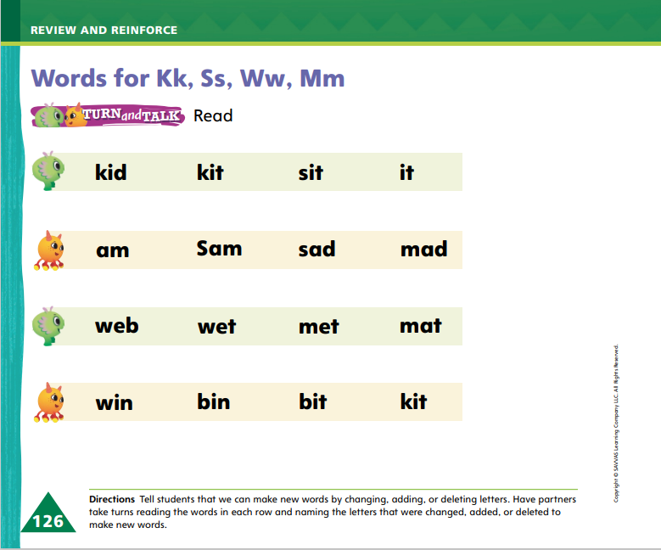
Page 126
Phonics
kin
Turn to page 126 in your Student Interactive and complete the activity.
win
am
Sam
Notes:
Write the word kin on the board. This is the word kin. I can read the word: /k/ /i/ /n/, kin. I hear the sound /k/ at the beginning. The sound /k/ can be spelled with the letter k.
Repeat with the word win. Then say: Look at the words kin and win. One letter was changed to make a new word. What letter was changed? Yes, the letter k was changed to the letter w.
Write am and Sam on the board. Read the words, and explain that the letter S was added to the word am to make the new word Sam. Write kit and it on the board. Read the words, and explain that the letter k was deleted, or taken away, from the word kit to make the new word it.
Today we are reviewing the sounds /k/, /s/, /w/, and /m/. Have students identify the letter that spells each sound. Write these words: at, sat, set, wet; Kim, Tim, Tam, am. Have students read the words and name the letter that was changed, added, or deleted to make each new word.
Have students turn to p. 126 in the Student Interactive. Have partners read the words and identify what letters were changed, added, or deleted to make the new words.

Slide 42
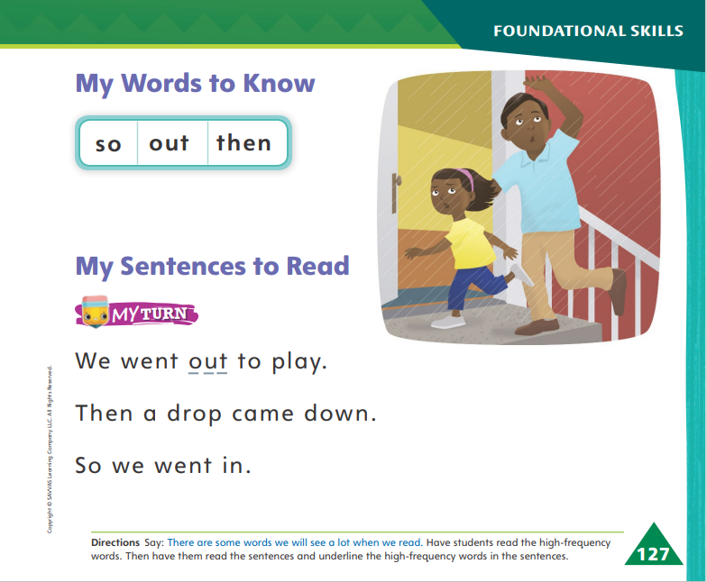
Page 127
High-Frequency Words
out
Turn to page 127 in your Student Interactive
so
then
Notes:
Tell students that today they are going to continue working with high-frequency words. You will see these words over and over in texts. Have students read the words at the top of p. 127 in the Student Interactive with you: out, so, then.
Have students look at the words at the top of p. 127. Tell them to identify and point to each word when you say it. Say out. Pause to let students find and point to the word. Say so. Say then. Repeat the activity until students are familiar with each word. Encourage students to use the words in sentences.
Have students read the words on p. 127 with you. Ask them to identify the words out, so, and then in the sentences. Have them underline the high-frequency words in the sentences. Then have the students read the sentences with a partner.

Slide 43
Page 137, 145
Compare and Contrast Texts
Notes:
Tell students that the more they read, the more they will be able to compare and contrast the different texts and ideas they read about.
Comparing means telling how things are alike.
Contrasting means telling how things are different.
Comparing and contrasting texts helps readers understand a topic.
Tell students that they should think about ways the texts are similar and different from each other.
Remind students that both Tornado Action Plan and Blizzard Action Plan give a plan about how to prepare for a storm. Model how to examine the steps in a process presented in each text.
I see a two-step plan on page 142 of Tornado Action Plan that tells how to prepare for a tornado. I must go to a safe area and wait for the storm to pass.
I can compare this to the three-step plan on pages 149–150 of Blizzard Action Plan. It tells me the steps for preparing for a blizzard. I must stay inside in warm clothes. But I can eat and play to stay warm!
The plans are alike because they both help me prepare for storms. But the plans are different, too. Tornadoes pass quickly so I just need to wait in a safe place. Blizzards take a longer time. I must stay warm during that whole storm.
Have students turn to the Close Read notes on pp. 141 and 149 and underline the words that tell what you should do to prepare for each type of storm.

Slide 44
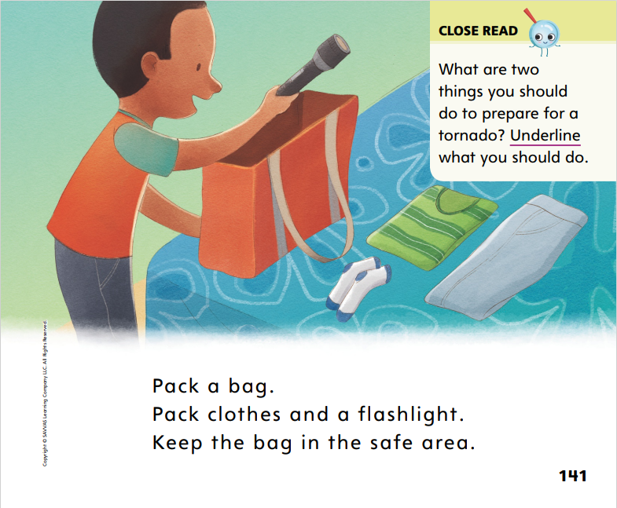
Page 141
Close Read – Compare and Contrast Texts
Turn to page 141 in your Student Interactive.
Notes:
Read aloud the Close Read note on p. 141 and work with students to identify details in the text that show what they should do during a tornado. Then tell students they will read another text about a weather safety plan. Work with students to determine how the two weather plans are alike and different. DOK 3

Slide 45
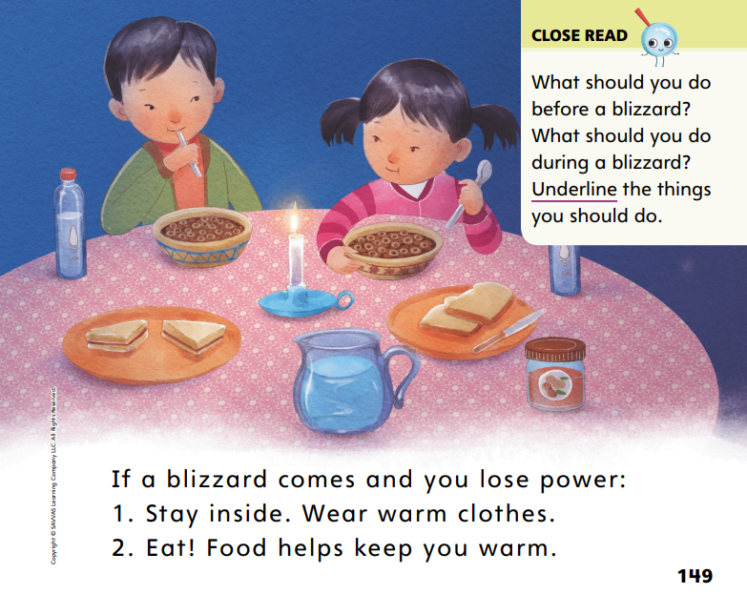
Page 149
Close Read – Compare and Contrast Texts
Turn to page 149 in your Student Interactive.
Notes:
Read aloud the Close Read note on p. 149. Help students find examples of what to do in a blizzard. DOK 3

Slide 46
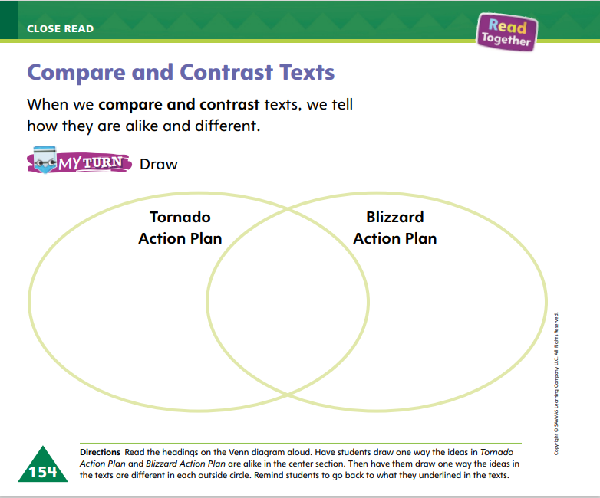
Page 154
Compare and Contrast Texts
Turn to page 154 in your Student Interactive and complete the activity.
Notes:
Have students use the strategies for comparing and contrasting texts.
Have students turn and talk with a partner about how a tornado and a blizzard are similar and different. Have them use the sentence frames: A tornado is like a blizzard. Both ___. A tornado is ___, but a blizzard is ___. Have students complete p. 154 in the Student Interactive. Make corrections to student responses as needed.

Slide 47
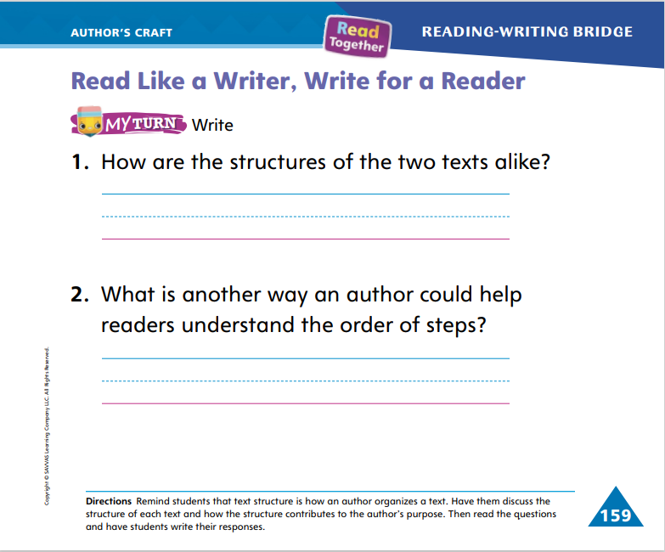
Page 159
Read Like a Writer, Write For a Reader
Turn to page 159 in your Student Interactive and complete the activity.
Notes:
Explain to students that the structure of a text is how the author puts the text together.
Some texts use many photos to tell a story or give information.
Some texts give steps to tell how to do something.
Some texts tell a story with no pictures.
Ask students to turn to p. 159 in the Student Interactive. Guide them to think about the text structure of both texts. Tornado Action Plan and Blizzard Action Plan have some things in common. Both are informational texts. There is also something about the structure, or the way they are put together, that is similar. Both have numbered steps.
Have students complete p. 159 of the Student Interactive.

Slide 48
Handwriting
It is hot.
Notes:
Remind students that sentences start with a capital letter and end with a period or other punctuation mark. We leave a tiny space between letters and a bigger space between words.
Demonstrate for students how to write a simple sentence. I want to write a sentence about the weather: It is hot. There are three words in this sentence. The first word is It. I need to use a capital letter. I write capital I and the letter t. Write the word It. I know I need to leave a space between words in sentences. I write the word is. I make sure to form the letters correctly. I leave another space before writing the last word, hot. I start by forming the letter h. Then I write an o and a t, making sure to form them correctly. Write the word hot. The sentence is finished, so I need to add a period. Add a period after the word hot.
Have students use Handwriting p. 275 from the Resource Download Center to practice writing simple sentences. Tell students to form letters accurately using appropriate directionality and to include spaces between the words. Click path: Realize -> Table of Contents -> Resource Download Center -> Handwriting Practice -> U5W4L3 Handwriting Practice

Slide 49
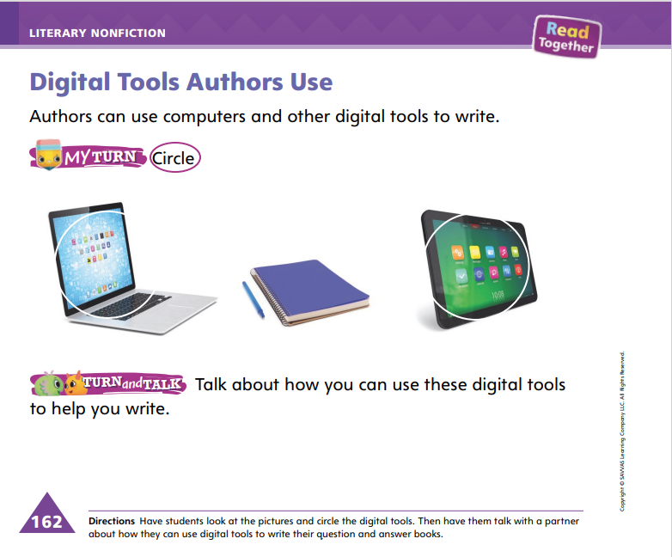
Page 162
Writing – Literary Nonfiction
Turn to page 162 in your Student Interactive.
Notes:
Authors can use computers, tablets, and other digital tools to write. Digital tools make writing easier. Authors can write on paper but may compose their final work using digital tools so it can be published or printed.
Write a question and answer from a stack text on the board, or make up one, such as: How old are children when they start kindergarten? Most children are five or six when they start school. Tell students that you want to transcribe your question and answer from paper to a digital tool. Model typing it on a laptop or tablet. Think aloud as you type your question and answer, using the space bar between words and using “delete” to fix errors and “return” to start a new line.
Ask students what they notice about using digital tools to write a book (it is neater, it is easy to read, etc.). Model how to add a picture to the page and how to use the spell-check feature. Explore other features of the software as time allows. Think aloud as you model saving the document, explaining that authors save their work on digital tools.
Direct students to complete the activity on p. 162 of the Student Interactive. Explain that digital tools do not include a pencil and paper.

Slide 50
Independent Writing
Continue writing, editing and typing your book.
Share your writing with the class. What do you like or dislike about using digital tools.
Notes:
During independent writing time, students should continue writing and editing. If resources allow, have students type their books on a laptop or tablet. Remind them to save their work.
Writing Support
Modeled - Think aloud as you transfer a hand-written book to a digital format.
Shared - Work with students to continue using digital tools to type their books. After they type each page, have them stop and read it to look for typing errors. Show them how to correct any errors.
Guided - Discuss why digital tools are important when writing a book. Help students begin or finish typing their books.
Have two or three students share their writing. Engage students in a discussion about what they like or dislike about using digital tools.

Slide 51
Spelling
skip
step
spot
Notes:
Remind students that words with initial consonant blends have two consonants at the beginning of the word. Both sounds are heard and spelled.
Have students write the following words as you isolate each phoneme: skip— /s/ /k/ /i/ /p/; step—/s/ /t/ /e/ /p/; spot— /s/ /p/ /o/ /t/.
Have students complete Spell Words p. 281 from the Resource Download Center. Click path: Table of Contents -> Resource Download Center -> Spelling -> U5W4L3

Slide 52
Language and Conventions
The blizzard brought strong winds.
Who baked the delicious cake?
Which word is the adjective in each sentence?
Notes:
Display and read the following sentence: The blizzard brought strong winds. Have students tell you which word in the sentence is an adjective. After they identify strong as an adjective, explain that the word strong tells about the winds.
Model another example: I just read this sentence: Who baked the delicious cake? The word delicious is an adjective. The word expanded the sentence and gave me more detail about the cake.
Provide additional examples as needed so that students can easily identify on their own how sentences can be expanded.

Slide 53
Lesson 4

Slide 54
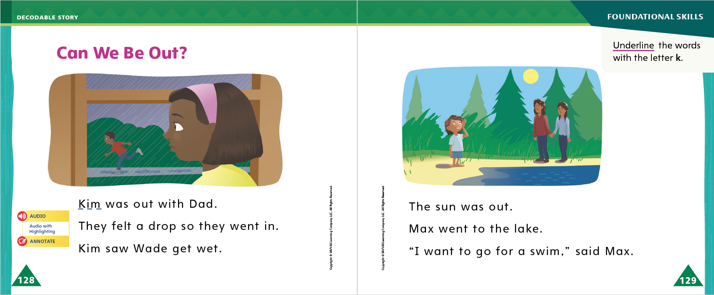
Page 128, 129
Decodable Story
out
so
then
Turn to pages 128, 129 in your Student Interactive. We will Read “Can We Be Out?”
Notes:
Have students turn to p. 128 in the Student Interactive. We are going to read a story today about children who do things outdoors. Point to the title of the story. The title is Can We Be Out? I hear a word with the sound /w/. Have students find and point to the word We. In this story, we will read other words that have the sounds /k/, /w/, /m/, and /s/.
Remind students of this week’s high-frequency words: out, so, then. Tell them they will practice reading these words in the story Can We Be Out? Display the words. Have students read them with you. When you see these words in the story Can We Be Out?, you will know how to identify and read them.
Have students whisper read the story as you listen in. Then have students reread the story with a partner. Listen carefully as they use letter-sound relationships to decode words. Partners should reread the story. This time the other student begins.
Call students’ attention to the sentences on pp. 128–129. Which words are high frequency words we learned this week? Point to them. Help students identify, or say, the words out and so.
Have students review the words with the letter k they read in the sentences on pp. 128–129. Have them underline the words with the sound /k/ spelled k. Then have students read the words to you.

Slide 55
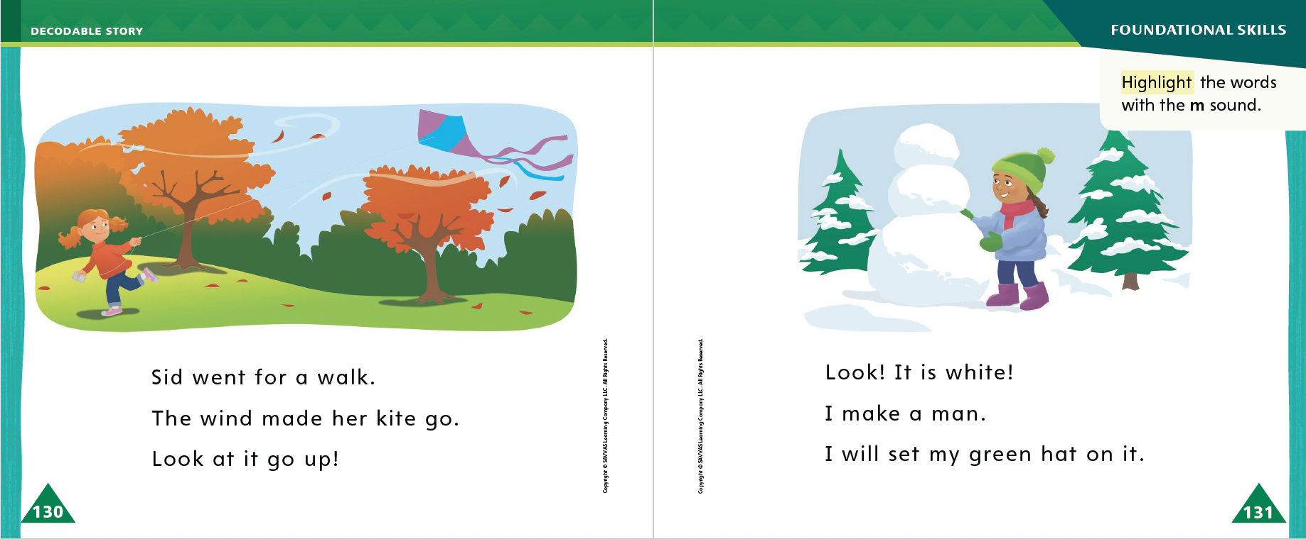
Page 130, 131
Decodable Story
Notes:
Have students turn to pp. 130–131. I see some words with the letter m. What sound does m spell? Students should identify, or say, the sound /m/. Have students highlight the words with the sound /m/ spelled m.

Slide 56
Page 137, 145
Ask and Answer Questions
Notes:
Tell students that one of the best ways to understand what they are reading is to ask questions about the text. Then they can look at the text again to find the answer.
Was there a word or idea you did not understand? Ask a question about it.
Look back at the pictures and reread the text to find details that will help you answer your questions.
If you are reading two similar texts, you can compare your questions and answers to help you understand how the ideas in the texts are connected.
Students learn to become better readers when they ask questions and then reread the texts to find the answers. Each new Close Read may help them answer their questions, but point out that not every question asked about a text can be answered by doing another Close Read.
Guide students through the process of asking and answering questions by examining the safety plan on p. 142 of Tornado Action Plan and using the rest of the text to help answer the question. Explain that they should look on different pages to find the answers to their questions.
On page 142 of Tornado Action Plan, the text says what I should do to stay safe in a tornado. I have a question: Why should I follow this plan?
I can look back in the text to try to answer the question I just asked about the tornado plan.
When I reread the text, I can see why I should follow the plan. On page 143, it says that a tornado action plan will keep me safe. I asked a question, and then I answered it.

Slide 57
Page 138, 139
Close Read – Ask and Answer Questions
Turn to page 138 in your Student Interactive.
Notes:
Read aloud the Close Read note on p. 139. Model how to ask questions about the text and look for the answers on the page. Point out the title on p. 137 and ask: What is a tornado? Then help students look on p. 138 for the answer. DOK 3

Slide 58

Page 146, 147
Close Read – Ask and Answer Questions
Turn to page 146 in your Student Interactive.
Notes:
Have students reread pp. 146–147 and discuss any ideas that confuse them about the text. Have them work in pairs to think of a question to ask about the text. Then help students highlight the words that provide the answer. DOK 3

Slide 59
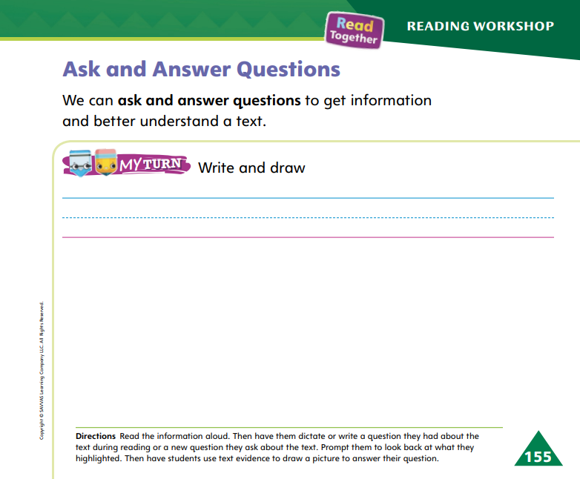
Page 155
Ask and Answer Questions
Turn to page 155 in your Student Interactive and complete the activity.
Notes:
Have students use the strategies for asking and answering questions about texts.
Direct students to complete the MyTurn activity on p. 155 in the Student Interactive. Have students work in pairs to ask and answer questions about the texts.

Slide 60
Writing – Literary Nonfiction
Look at the pictures in the text.
Think about ways to publish your writing using digital tools.
What are other ways we can share our writing using a digital tool?
Notes:
Publishing means printing a book or sharing it with others. Before authors publish their books, they can use digital tools to add graphics, change fonts, bold or italicize words, or change the color of the text. Authors can use digital tools to publish their writing.
Use a stack text to show how words are formatted in a book. Point out colored text, bold fonts, different type faces, different size fonts, etc. Tell students that it would be difficult to create all of these different sizes and colors of text by hand. Digital tools make it easier for authors to create pages for their books.
Choose another stack text and have students identify the different fonts and images they see. Engage students in a discussion about how each element might be hard to create with pencil and paper, but digital tools make it easy for authors to create their books.
Say: To publish a book means to finalize it and share it with others. This author published his book by printing it. There are other ways to publish our writing using digital tools. What are some other ways we can share our writing using a digital tool, such as a computer?
Work with students to brainstorm and list other ways that digital tools can be used to share writing, such as sending it through email, posting it on a message board, sharing it on social media, or making a video of someone reading the book.

Slide 61
Independent Writing
Continue writing/typing your book. Try changing the font or the text color.
Share your published book with the class.
Notes:
Have students continue writing and revising their books. If resources allow, have students type their books on a computer and encourage them to try changing the font or text color.
Writing Support
Modeled - Think aloud as you transcribe your writing to a laptop or tablet.
Shared - Together, talk through the steps to write and publish writing. Engage in a conversation about adding graphics or changing fonts or colors.
Guided - Prompt students to talk about the ways they can make their books more interesting by adding graphics or changing the text. Help them come up with some ideas for their own books.
Have a few students share their published books with the class. Engage students in a discussion about why authors want to publish their writing.

Slide 62
Spelling
at
am
an
Notes:
Have students recall the previous spelling rules for spelling words with the VC pattern.
Read the following words and have students spell them: at, am, an.
Have students work in pairs. Ask one partner to say a sentence with a VC word and the other partner to identify the VC word and spell it. Then have partners switch roles.

Slide 63
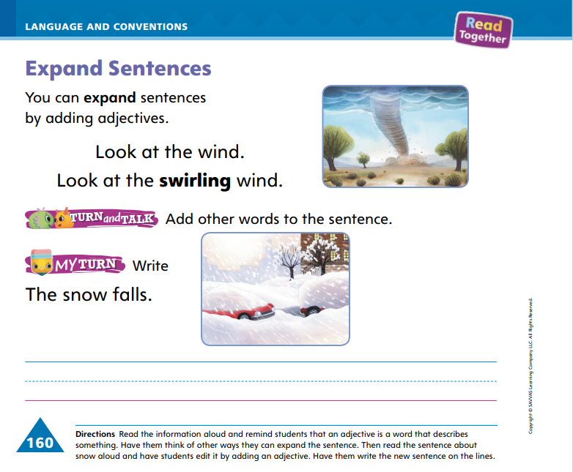
Page 160
Language and Conventions
Turn to page 160 in your Student Interactive and complete the activity.
Notes:
Have students complete the activity on p. 160 in the Student Interactive.

Slide 64
Lesson 5

Slide 65
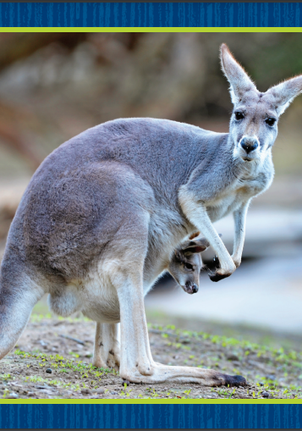
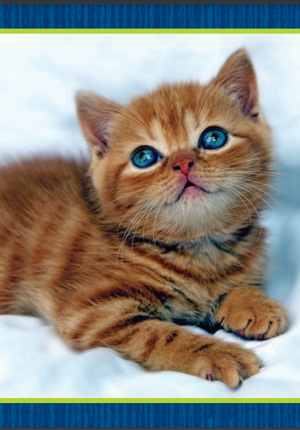
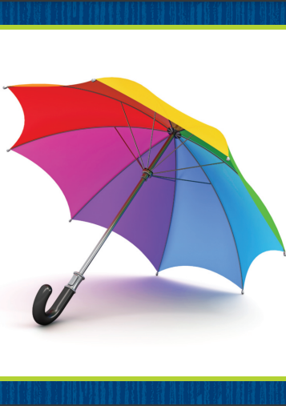
Phonological Awareness
Notes:
Display the kangaroo Picture Card. This is a picture of a kangaroo. Listen carefully as I count the syllables: kan (clap) ga (clap) roo (clap). How many times did I clap? Students should say three. How many syllables are in kangaroo? Students should say three. If I take away the first two syllables, what do I have left? Students should say roo. If I take away the last two syllables, what do I have left? Students should say kan. If I take away the first and last syllables, what do I have left? Students should say ga.
Repeat the routine with the kitten and umbrella Picture Cards. Click path -> Table of Contents -> Unit 5 Week 4 Informational Text -> Lesson 5

Slide 66
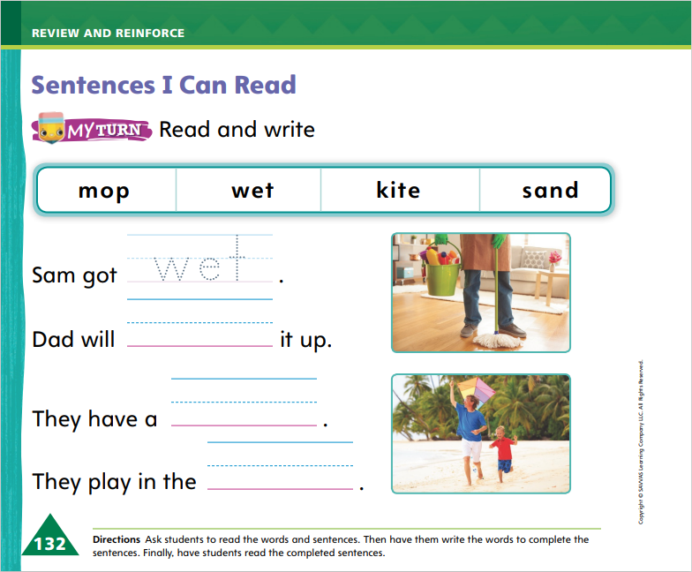
Page 132
Phonics
Turn to page 132 in your Student Interactive and complete the activity.
Notes:
Tell students that today they will read some sentences. The sentences we read will all include sounds and high-frequency words you have already learned.
Have students turn to p. 132 in the Student Interactive. Use letter-sound relationships to decode the words in the bank with students. Have a volunteer read the first sentence and tell you which word from the bank belongs in the sentence. Guide students as they trace wet on the line. Then have a student read the sentence.
Guide students to finish p. 132 in the Student Interactive.

Slide 67
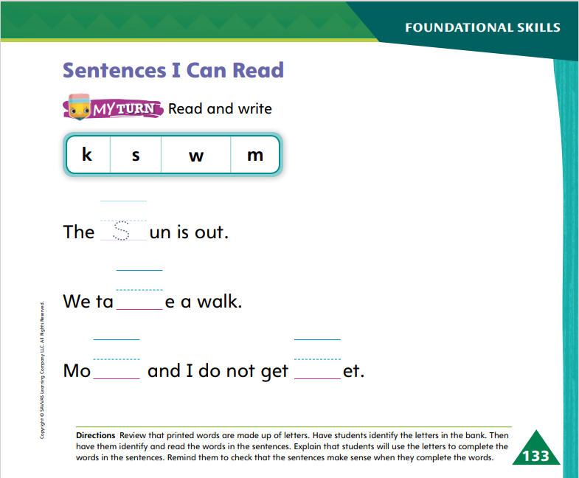
Page 133
Apply
Turn to page 133 in your Student Interactive and complete the activity.
Notes:
Have students look at p. 133 in the Student Interactive. Have them identify the letters in the bank.
Then have them fill in the correct letter to complete the word in each sentence.

Slide 68
High-Frequency Words
out
so
then
Notes:
Remind students that high-frequency words are words that appear over and over in texts.
Remind them they are learning many of the words this year, and the words will help them become better readers.
Say the word out and ask students what letters spell the word.
Have students
say the letters as you write them on the board.
say and spell the word, touching their toes for each letter.
repeat with so and then.

Slide 69
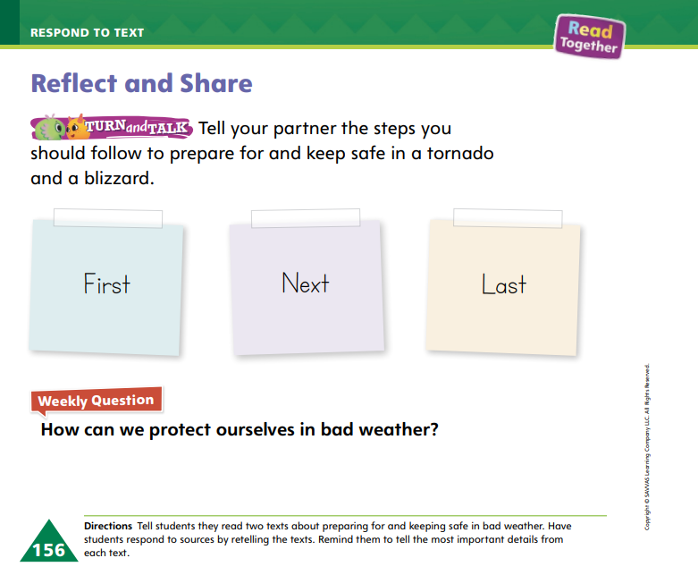
Page 156
Reflect and Share
Turn to page 156 in your Student Interactive and complete the activity.
Notes:
Explain to students that, after they compare and contrast two texts, it is important to think about what they learned. Tell students that after they compare the texts, they should
be able to summarize how the texts are alike.
be able to summarize how the texts are different.
share information and ideas using complete sentences.
ask questions to understand information they hear and answer questions about their own ideas.
Ask students to turn to p. 156 in the Student Interactive. Reread the text for students. This activity can help me compare the texts I read. It can help me name the steps in a process too. Instead of using a numbered list like in the texts, I can use the words first, next, and last. First, I’ll think about tornadoes. Next, I’ll think about blizzards.
Provide additional examples of possible thought processes that students can use to handle the Reflect and Share activity on p. 156.
Have students complete the Turn and Talk activity on p. 156 in the Student Interactive by talking with a partner about the steps for preparing for a tornado or blizzard. Then have them compare the texts by talking about how the steps are alike and different.

Slide 70

Page 156
Apply
How can we protect ourselves in bad weather?
Discuss in your group.
Notes:
Have students use evidence from the texts they have read this week to respond to the Weekly Question.
Tell them to discuss in small groups.

Slide 71
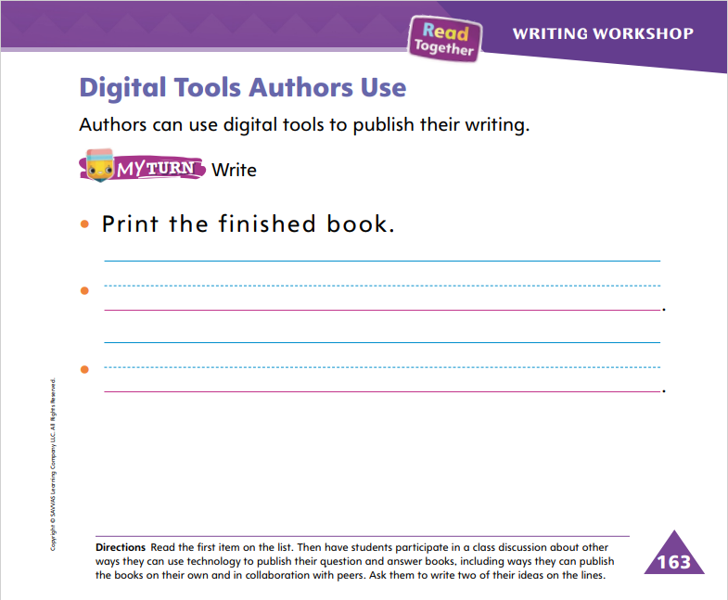
Page 163
Writing – Literary Nonfiction
Turn to page 163 in your Student Interactive.
Notes:
Authors use digital tools to publish their writing. Before publishing a book, authors finalize how they want it to look. They use digital tools to format their books and add graphics.
Think aloud as you write a question and answer on the board. You can copy a page from a stack text or think of your own question and answer, for example: What do kindergarteners learn in school? Kindergarteners learn about numbers, letters, and how to be part of a community. Reread what you wrote, asking students for suggestions to make the question and answer better. Incorporate their changes and talk through revising your writing. When the writing is final, tell students you will publish it using a digital tool. Type your question and answer on a laptop, computer, or tablet. If possible, scan in a drawing or use stock images or clip art, thinking aloud as you choose the graphics. Print out the finished product and show students the published work.
Then say: One way to publish writing using digital tools is to print a copy like I just did. To publish a book means to share it with others. What other ways can you share your writing using computers and other digital tools?
Discuss with students the various ways you can share a book online, such as sending it through email, posting it to social media, making a video, or creating a sound recording.
Direct students to complete the activity on p. 163 of the Student Interactive.
Have a few students read their published books aloud to the class. Prompt students to discuss another way they would like to publish their writing.

Slide 72
Spelling
Molly likes to skip.
Dad cleaned the dirty spot from my shirt.
We missed the first bus, so we got on the second bus.
I want to learn to swim.
We will learn the first step of the dance.
We can take the dog out.
Notes:
(Note: Move the orange boxes to cover each bold spelling word before you read aloud the words and sentences.)
Read aloud the words and sentences. Have students spell each word with initial consonant blends and the two high-frequency words.
Molly likes to skip.
Dad cleaned the dirty spot from my shirt.
We missed the first bus, so we got on the second bus.
I want to learn to swim.
We will learn the first step of the dance.
We can take the dog out.
Reveal the spelling word and have students check their work.

Slide 73
Language and Conventions
We will go to the busy market to buy apples.
Which word expands the sentence by describing the market?
go
busy
buy
apples
Notes:
Display the following sentence and guide students to answer the question. We will go to the busy market to buy apples.
Which word expands the sentence by describing the market?
Go
Busy
Buy
apples
Have students complete Language and Conventions, p. 287, from the Resource Download Center. Click path: Table of Contents -> Resource Download Center -> Language and Conventions -> U5 W4

Slide 74
Unit 5: Week 4
Grade K

